Slide 1


Slide 2
Purpose
Environmental scanning is a process undertaken by an organization to systematically gather and interpret relevant data to identify external and internal conditions, forces and trends that could impact its ability to fulfill its mission
Students, faculty, staff, administration, Board members and community members engaged in strategic planning are the scan’s audience
The environmental scan is intended to:
  Provide data that describe NIC’s internal and external environments
  Identify key environmental factors
  Be a key resource / reference document
  Provide a foundation for discussion
  Be question generating / thought provoking

Slide 3
Key Factors and Trends
Key environmental factors are those factors/conditions that represent important considerations for strategic and short-term planning and operations as NIC works to achieve its mandates, mission and vision.
Notes:
Themes are particularly relevant to post-secondary educational institutions
Themes are thought provoking
STEEP is largely externally focused. Could use STEEP on external and have a separate section for internal.

Slide 4
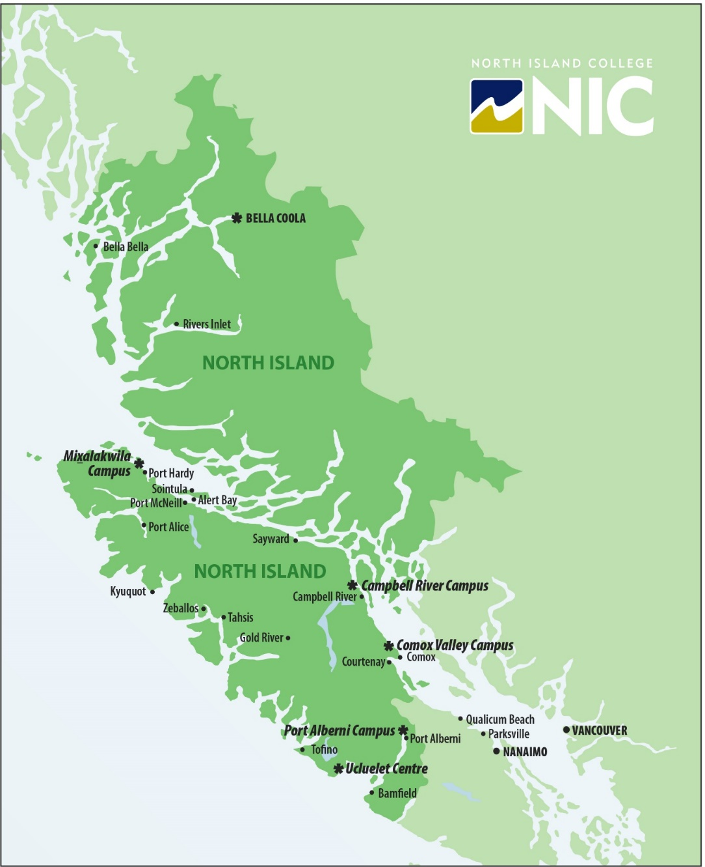
Large and geographically diverse region

Slide 5
Large and geographically diverse region
The College serves a vast and diverse region on central and northern Vancouver Island and B.C.’s Central Coast
  80,000 km²
  157,000 residents
  35 First Nations
  Six school districts
  Five regional districts
In addition to campus-based offerings, NIC delivers education through:
  Online and distance learning
  Interactive television
  Face-to-face in communities

Slide 6
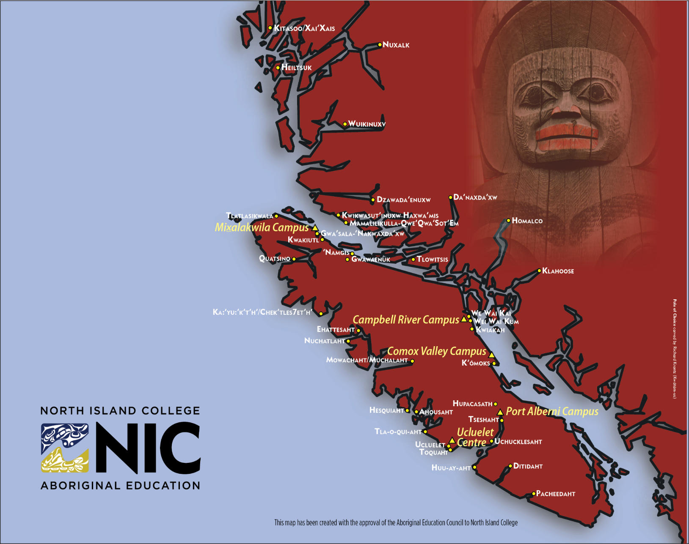
Indigenous peoples

Slide 7
Indigenous peoples
  35 First Nations
  13% of the NIC region’s population is comprised of Indigenous peoples
  21% of NIC’s domestic student population enrolled in credit courses (19% of FTEs) is of self-declared Aboriginal ancestry
  Younger than the overall population with 15-24 year-olds making up 16% of the Indigenous population compared with 9% of the overall population
  Regional districts where the largest number of Indigenous people live are:
    Alberni-Clayoquot (6,035 | 20%)
    Strathcona (5,855 | 13%)
  Regional districts with the highest percentages of Indigenous people:
    Central Coast (2,045 | 62%)
    Mount Waddington (3,340 | 31%)

Slide 8
Low preparedness for post-secondary education
  Just under one-quarter (23%) of secondary school students in the NIC region do not graduate high school versus 16% for the province overall
  13% of 25-64 year olds living in the NIC region don’t have at least a high school diploma compared with 10% provincially
  Within the NIC region, the percentage of individuals with no high school diploma is:
      HIGHEST Mount Waddington and Central Coast, both at 23%
      IN THE MIDDLE Strathcona (12%) and Alberni-Clayoquot (18%)
      LOWEST Comox Valley at 9%
  Just under one in four diploma, associate degree and certificate students surveyed in 2018 (23%) took Adult Basic Education during, or prior to, their studies, a comparatively high proportion relative to other B.C. public post-secondary institutions - 18% for rural colleges and 12% for the rest of the B.C. college, institute and teaching intensive university sector

Slide 9
High proportion of regional population with no post-secondary education
  43% of 25-64 year olds in the region have no post-secondary credential compared with 37% provincially
  Within the NIC region, the percentage of individuals with no post-secondary credentials is:
    HIGHEST Mount Waddington and the Central Coast, both at 52%
    IN THE MIDDLE Strathcona (44%) and Alberni-Clayoquot (48%)
    LOWEST Comox Valley at 38%

Slide 10
High proportion of regional population with no post-secondary education
  77% of the 903,000 job openings expected in the next decade in B.C. will require some level of post-secondary education or training
    41% will be in occupations requiring a diploma, certificate or apprenticeship training
    36% will be in positions requiring a bachelor’s, graduate or first professional degree
    23% of job openings will be available for those with a high school education or less

Slide 11
Ageing Population

Slide 12
Ageing Population
  The proportion of individuals aged 65+ living in the NIC region is substantially higher than that seen provincially (25% versus 20%) and by 2030 this will shift even higher to 30% in the NIC region versus 24% for the province

Slide 13
Shrinking number of 18-24 year-olds
  The traditional post-secondary population of 18-24 year-olds in the NIC region is projected to decrease by 4% (466 people) between 2020 and 2025
    The decline is expected to reverse after 2025, however, with expected growth of 3% (356 people) over 2020 levels by 2030
  Provincial numbers are expected to decline by 11% between 2020 and 2025 but by 2030 they will rebound substantially, showing a decline of only 7% over 2020 levels

Slide 14
Slowly recovering secondary school enrolment

Slide 15
Pending employee retirements

Slide 16
Pending employee retirements
  35% of NIC employees are over 55
  (beyond the age of early retirement)
  37% of NIC employees are in the 46-55 age group
  Employee groups over 55
    Faculty is the highest at 43%
    Support staff and administrators are at 27% and 24%, respectively

Slide 17
Low unemployment
  B.C.’s unemployment rate averaged 4.7% in 2018, the lowest among the provinces
  Research has shown that “employment and unemployment rates much more than the number of high school graduates or other population trends – which are important over time but very slow moving – are the biggest factors driving enrolment for community colleges, for-profit colleges and some open-access four-year institutions”
  Inside Higher Ed. 2015. Retrieved March 26, 2019 from: https://www.insidehighered.com/views/2015/08/27/unemployment-rate-community-college-enrollments-and-tough-choices-essay.

Slide 18
high reliance on provincial government funding
$2.7M Fewer Dollars

Slide 19
Rapidly growing international student demand

Slide 20
Rapidly growing international student demand
  International student enrolment at NIC has grown almost ten-fold over the past decade
  13% of students enrolled in credit courses at NIC (18% of FTEs) are international students
  Rapid growth in international student demand has spurred a focus on sustainable admissions and enrolment practices, student services and learning environments

Slide 21
Tuition

Slide 22
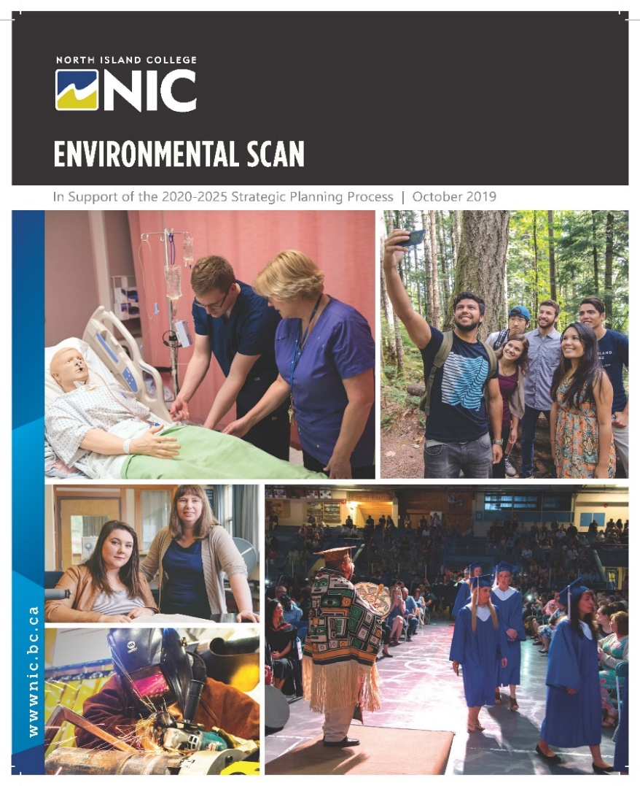
Final Thoughts
The Environmental Scan can be found on the NIC website
ABOUT US / THE NIC COMMITMENT / REPORTING
https://www.nic.bc.ca/pdf/nic-environmental-scan-2019.pdf
Provide us with your thoughts on the topics covered
in today’s presentation!
http://www.nic.bc.ca/Regional-Forum-Survey

